Slide 1
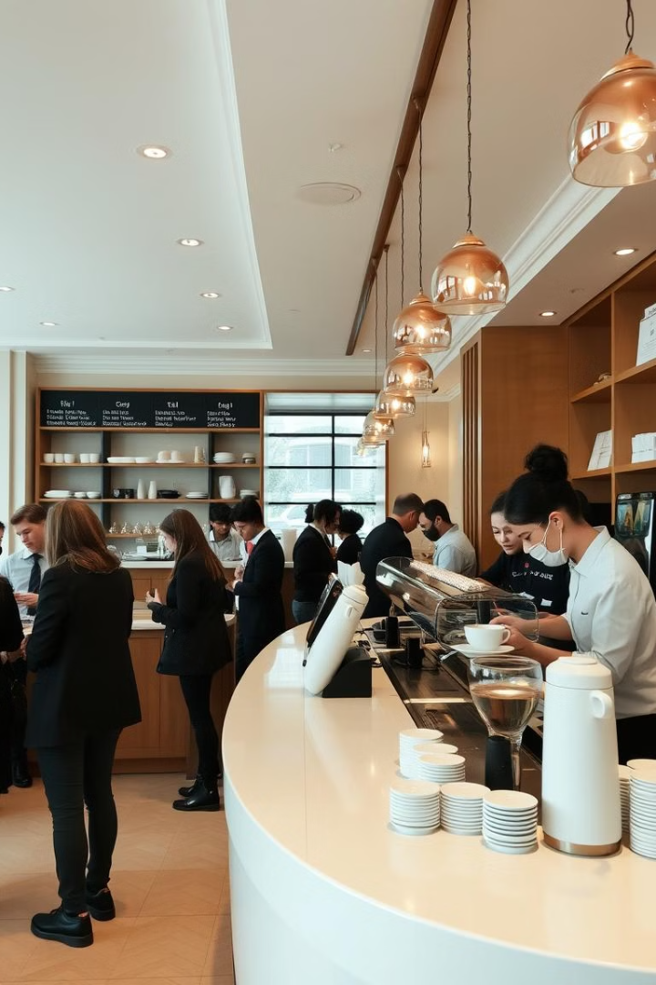
Coffee Shop Sales Analysis: Unlocking Growth Opportunities
This report analyzes coffee shop sales data to identify key trends and actionable insights for improving performance.

Slide 2
Revenue by Store Location
Top Performer
Area for Improvement
Hell's Kitchen location generated 34% of total sales.
Lower Manhattan locations showed lower performance.

Slide 3
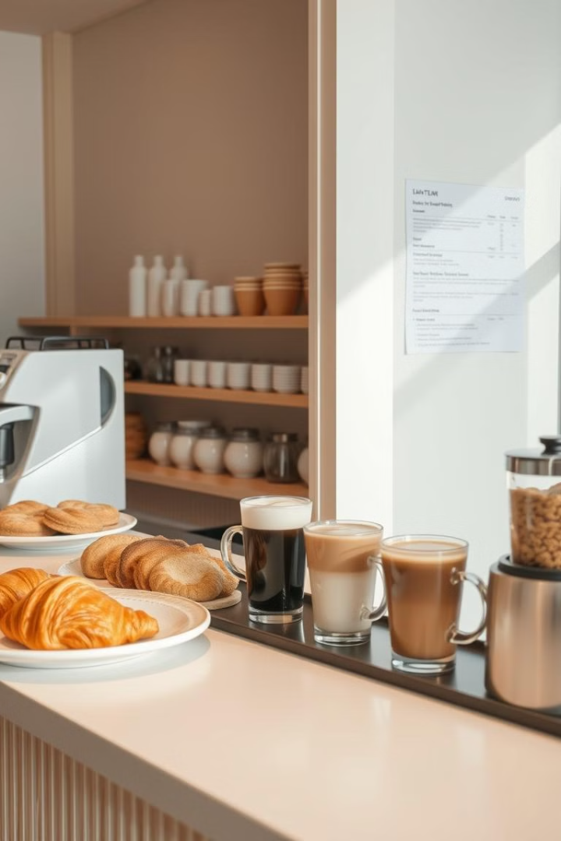
Top-Selling Products
1
1. Barista Espresso
2
2. Brewed Black Tea
Highest-selling product, with a total sales quantity of $91,406,20.
Strong performer, indicating customer demand for alternative beverages.

Slide 4
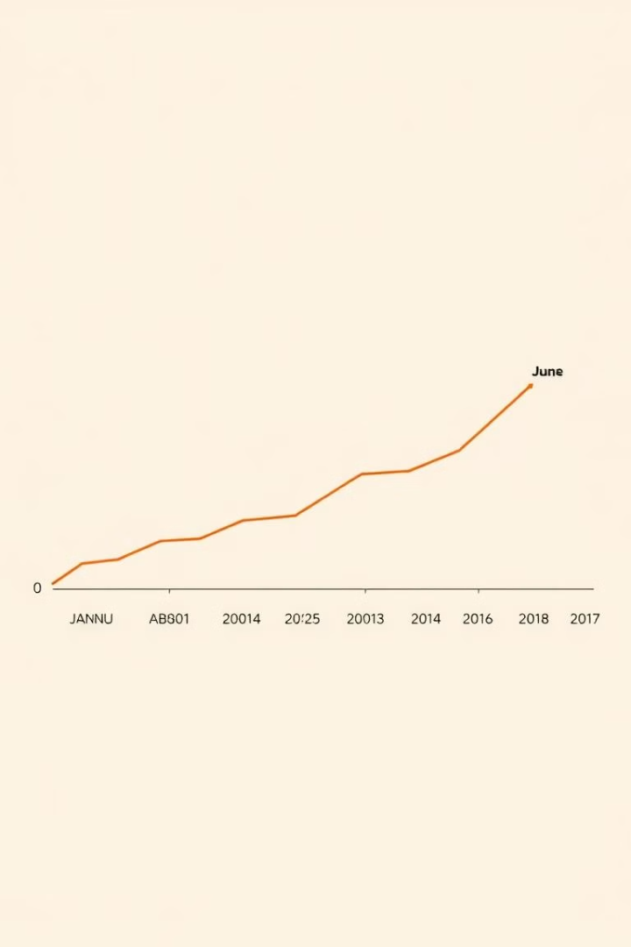
Revenue by Month
1
June
Highest-earning month, contributing 24% of total annual revenue.
2
February
Lowest revenue, possibly due to seasonal factors or reduced promotions.

Slide 5
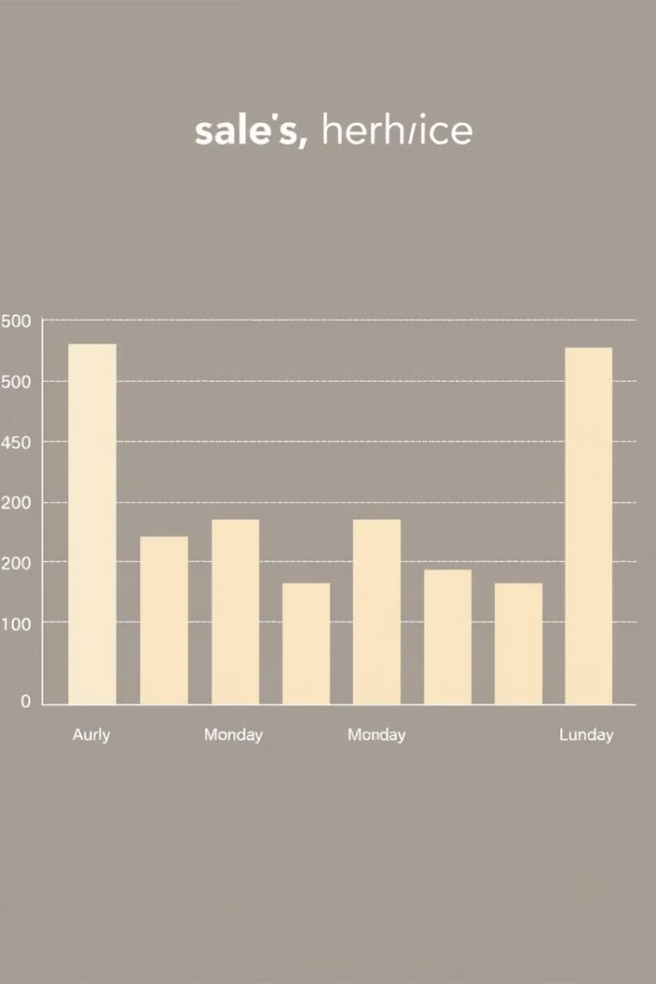


Sales by Day of the Week
Monday
Busiest day, with total revenue reaching 101677.28.
Saturday
Lower performance compared to weekdays, suggesting potential for optimization.

Slide 6

Average Price Per Order
4.69
Average Spend
Provides insight into customer spending behavior.

Slide 7

Recommendations: Boosting Performance
Targeted Marketing
Leverage Popularity
Introduce promotions and campaigns in low-performing stores.
Focus on promoting top-selling products with special offers.
Seasonal Promotions
Plan promotions during low-revenue periods based on monthly trends.

Slide 8

Conclusion: Towards Sustainable Growth
By implementing these recommendations, the coffee shop can achieve better customer satisfaction, increased revenue, and sustainable growth.

